Slide 2
Bullying Types

Slide 3
Examples of Bullying

Slide 4
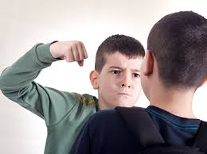
Examples of Bullying

Slide 5
Victims of Bullies

Slide 6
Victims of Bullies

Slide 7
How to stop bullying

